Slide 1
TDI Capstone Project
Assessing SBA data to predict loan defaults, optimization

Slide 2
SBA Basics
The SBA was established with the purpose of promoting and assisting businesses get credit in the market.
While there are success stories, there are also instances of businesses defaulting on their SBA loans.
Based on the data, can we derive insights on how to better target lending programs in order to maximize return on investment/minimize defaults?

Slide 3
Problem Statement
What is the distribution of the time to default on a loan?
Is there a correlation on the loan amount and the charged-off amount?
Is there any correlation between defaults and other external actions (e.g. recessions, massive industry changes)?
Is there a way to predict defaults in advance?
Industry
Geography

Slide 4
Initial Analysis
Exploration of the columns contained in the dataset.
Determining number of columns, rows, data types
Cleaning of data:
Removal of rows with null data for columns of interest
Formatting of columns of interest so that calculations can be performed
Generation of plots
Calculation of statistics:
Mean
Standard deviation

Slide 5
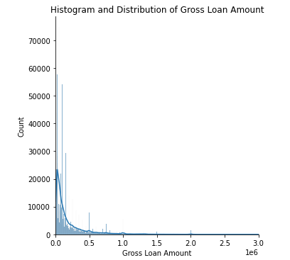
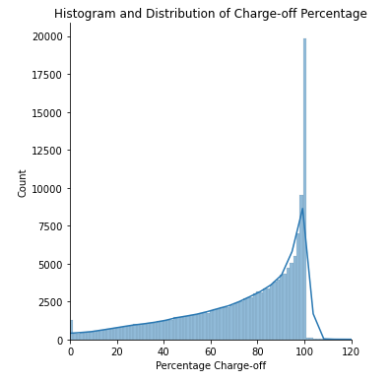
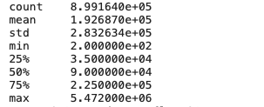
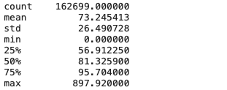
Statistics and visualizations

Slide 6
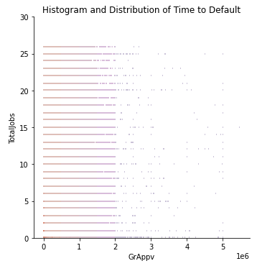
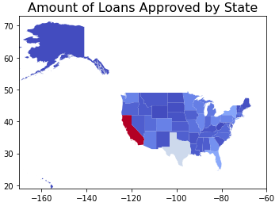
Statistics and Visualizations (Cont’d)
The loan amount does not appear to influence number of jobs created/retained
Businesses in CA receive most loans
There is good correlation between size of state and loans issued

Slide 7
Classification Models
Logistic Regression
Included categorical features (New/Existing, Urban/Rural, Franchise, Industry)
Included quantitative features (Total Jobs, Gross Amount Approved, SBA Guaranteed Approved)
Model does not make better predictions than the majority class as illustrated by model score and confusion matrix on a test/train split dataset
Random Forest Classifier
Included categorical features (New/Existing, Urban/Rural, Franchise, Industry)
Included quantitative features (Total Jobs, Gross Amount Approved, SBA Guaranteed Approved)
Model improves slightly compared with a basic logistic regression as illustrated by score, confusion matrix.

Slide 8
Solution
Optimize the loan amount in terms of the jobs created/retained
Anomaly detection

Slide 9
Annex
SBA Dataset obtained from Kaggle
Dataset:
~ 46 MB
899164 rows, 27 columns
Data around borrower, loan amount, charged-off amount, guaranteed amount, dates
Python Libraries: Pandas, Matplotlib

